Slide 1
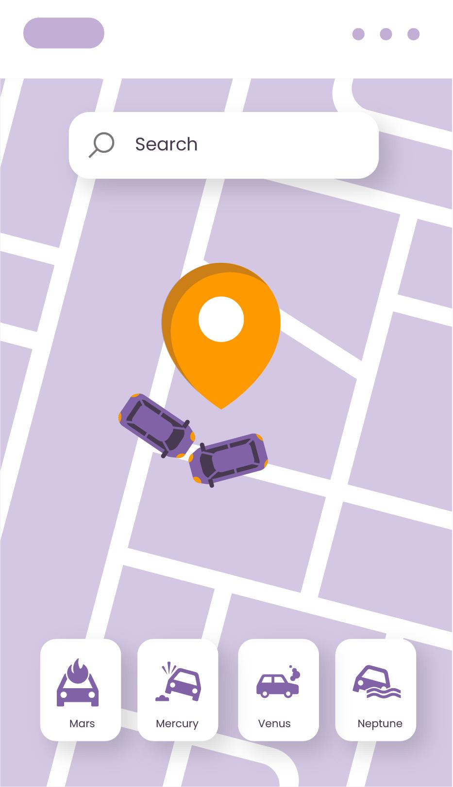
An Intelligent Highway Traffic Management System
REPORT!
Group 4

Slide 2
Table of contents
01
02
03
04
05
06
Introduction
Objectives
Summary
NS-3 Code
Simulation
Results

Slide 3
Group 4 Members
Heba Mostafa
Aya Metwally
Amira Abu Issa

Slide 4
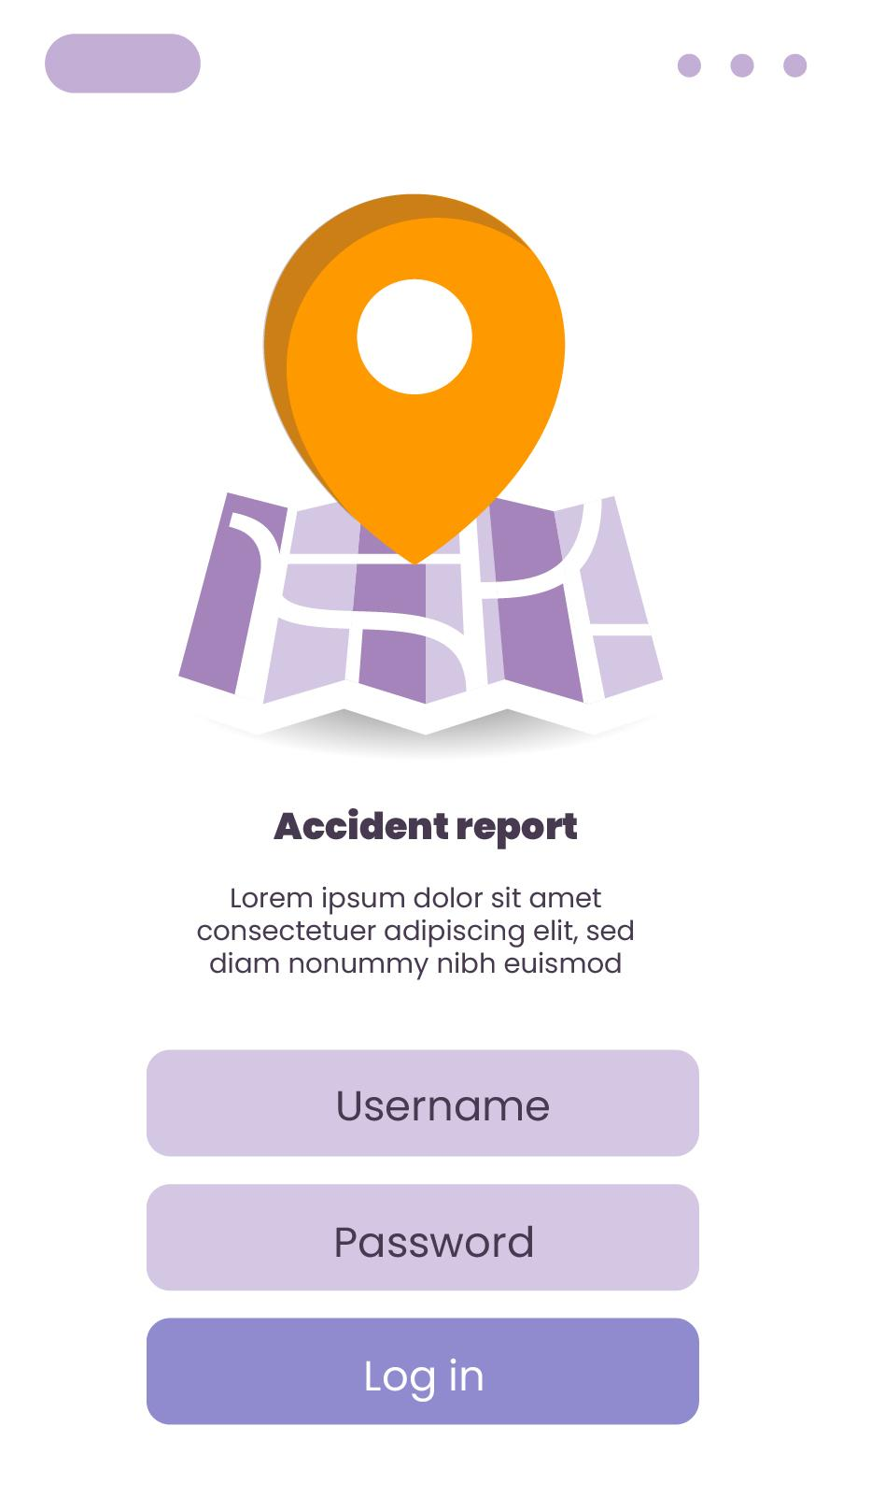
01
Introduction
ACCIDENT!

Slide 5
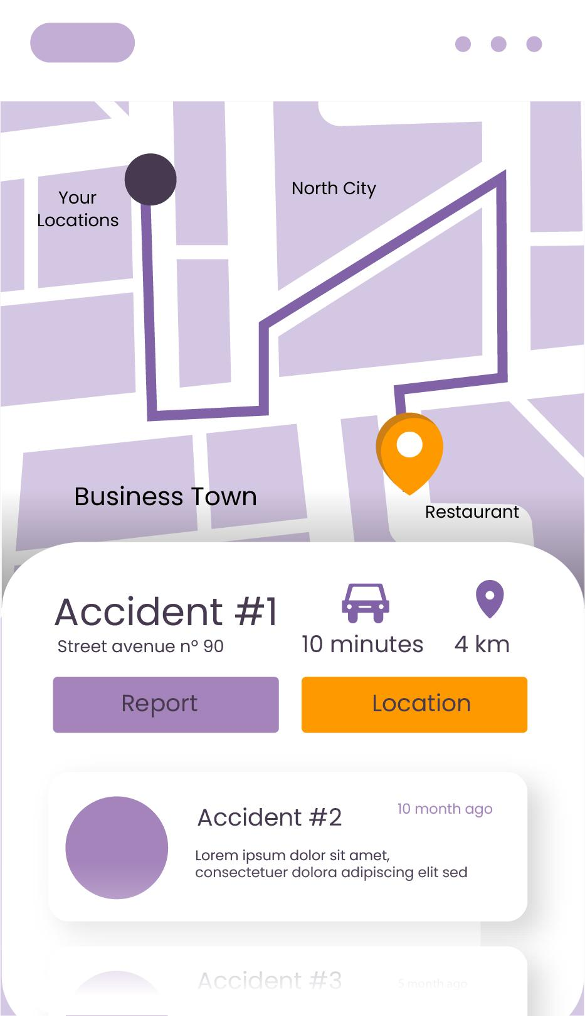
Introduction
REPORT!
The main problem is the reduction of traffic congestion and improvement of safety on highways during accidents.

Slide 6
02
Objectives
ACCIDENT!

Slide 7
Objectives
Performance
Communication
Decision-making
Develop an intelligent highway traffic management system that can promptly detect accidents and hazards.
Design a communication protocol that allows vehicles and Road Side Units (RSUs) to exchange real-time traffic information efficiently.
Implement decision-making algorithms on On-Board Units (OBUs) to provide timely warnings and suggest alternative routes to vehicles behind the accident area.

Slide 8
Networking Concepts
Quality of Service (QoS)
Traffic Security
It promptly detects accidents, warns nearby vehicles, and suggests appropriate actions, thereby reducing the impact of accidents on traffic flow.
The system incorporates secure communication protocols for the exchange of real-time traffic information between vehicles and Road Side Units (RSUs).
Real-Time Information
Scalability
The system's ability to provide real-time information about traffic conditions, travel times, and alternative routes empowers drivers to make well-informed decisions.
As a smart city grows and its traffic demands change, the system can be expanded and modified to accommodate the evolving needs.

Slide 9
03
Summary
ACCIDENT!

Slide 10
An Intelligent Highway Traffic Management System For Smart City
This article discusses the proposed work to reduce congestion in a lane during accidents by providing relevant information to vehicles behind the accident area. This approach is specifically designed for the 2-lane highway.
Reference: Mandal, P., Chatterjee, P., & Debnath, A. (2019). An intelligent highway traffic management system for smart city. In Intelligent Computing: Proceedings of the 2019 Computing Conference, Volume 1 (pp. 1-10). Springer International Publishing.

Slide 11
Relevance Work
The authors discuss some works on smart traffic management systems:
• Javaid et al. proposed a hybrid approach to optimize traffic flow on roads [1].
• Junping et al. introduced an intelligent transportation system that can accumulate a large volume of data from various sources using video sensors [2].
• Wiering et al. proposed a learning algorithm-based adaptive control system to manage traffic lights [3].

Slide 12
04
NS-3 Code
ACCIDENT!

Slide 13

Simulation Setup
The simulation is carried out using NS3
The necessary header files from the NS-3 library:

Slide 14
NS-3 Code Steps
Include the necessary header files from the NS-3 library
Create function to handle received traffic information at RSUs
Create function to send traffic information from vehicles to RSUs
Create seven nodes in which six are dynamic vehicles and another one that is static RSU
Assign mobility models for vehicles
Install the internet stack on nodes
Set up UDP sockets for communication
Visualize the simulation using NetAnim

Slide 15
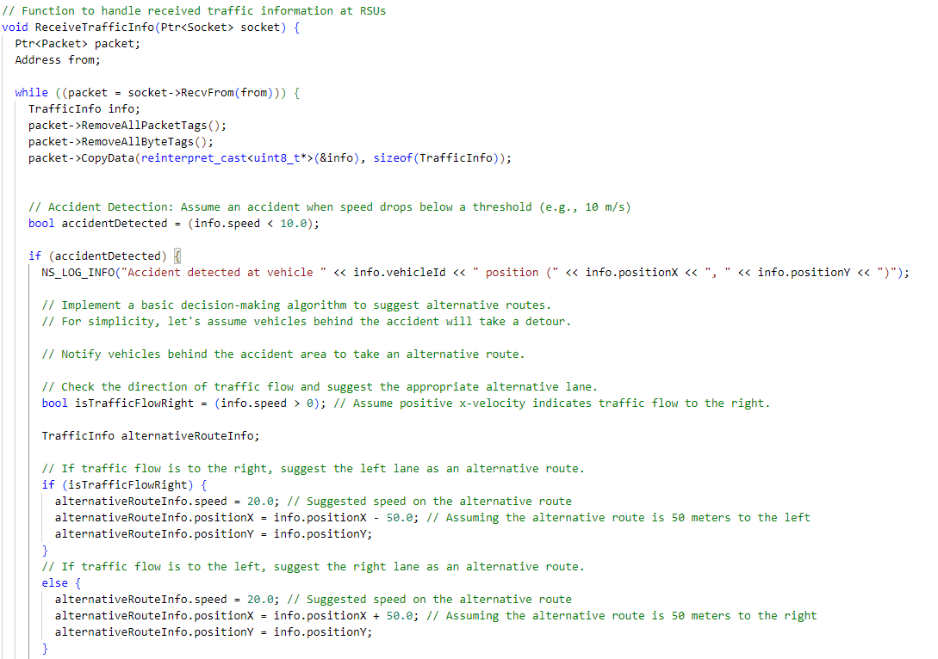
NS-3 Code Steps
Function to handle received traffic information at RSUs

Slide 16
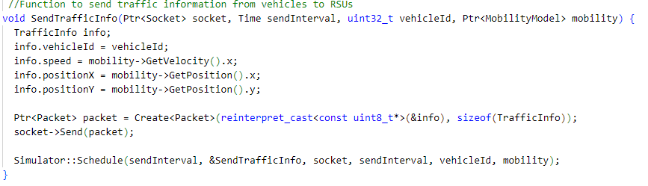
NS-3 Code Steps
Function to send traffic information from vehicles to RSUs

Slide 17
05
Simulation
ACCIDENT!

Slide 18
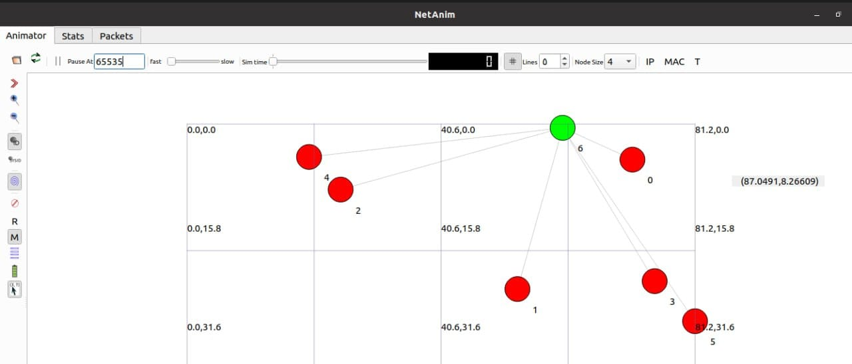
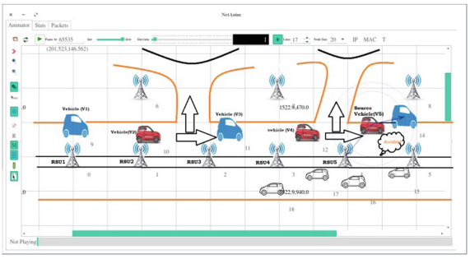
Simulation Results

Slide 19
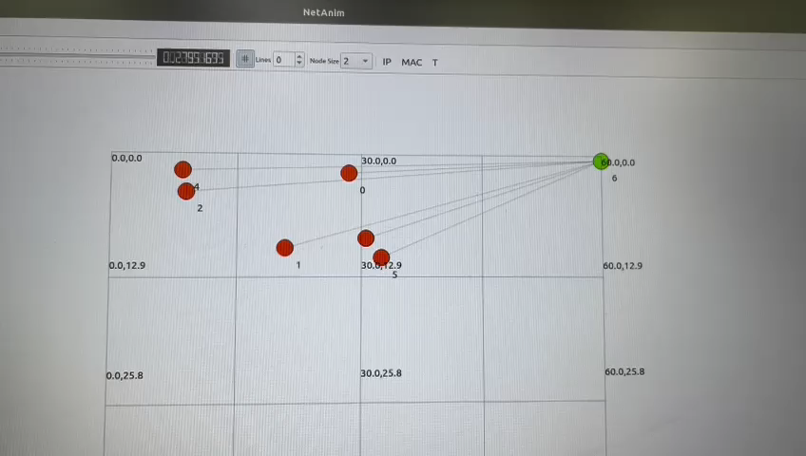
Simulation Results

Slide 20
06
Results
ACCIDENT!

Slide 21
Analysis and Findings
Accident Detection
Alternative Route Suggestion
Communication and Traffic Information
Visualization
Flow Monitor

Slide 22
Challenges
Real-Time Data Processing
Communication Reliability
Scalability

Slide 23
Resources
ACCIDENT!
[1] Javaid, S., Sufian, A., Pervaiz, S., Tanveer, M.: Smart traffic management system using Internet of Things. In: International Conference on Advanced Communication Technology, ICACT 2018, Chuncheon-si, Gangwon-do, Korea (South), pp. 393–398, February 2018. https://ieeexplore.ieee.org/document/8323770
[2] Junping, Z., Feiue, W., Kunfeng, W., WeiHua, L., Xin, X., Cheng, C.: DataDriven intelligent transportation systems: survey. IEEE Trans. Intell. Transp. Syst. 12(4),1624–1639 (2011)
[3] Wiering, M., Veenen, J., Vreeken, J., Koopman, A.: Intelligent traffic light control, pp. 1–30, Technical report, Department of Information and Computing Sciences, Universiteit Utrecht, 9 July 2004.

Slide 24
THANKS!

